Slide 1

REGULAR MEETING OF THE ARKANSAS HIGHER EDUCATION COORDINATING BOARD
January 23, 2026

Slide 2
AHECB Members
Dr. Jim Carr, Chair
Lucas Pointer, Vice Chair
Dr. Katherine Dudley, Secretary
Graycen Bigger
Dr. Jerry Cash
Heather Maxey
Carolyn Rhinehart

Slide 3
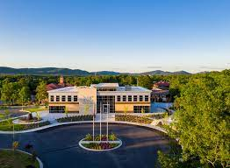
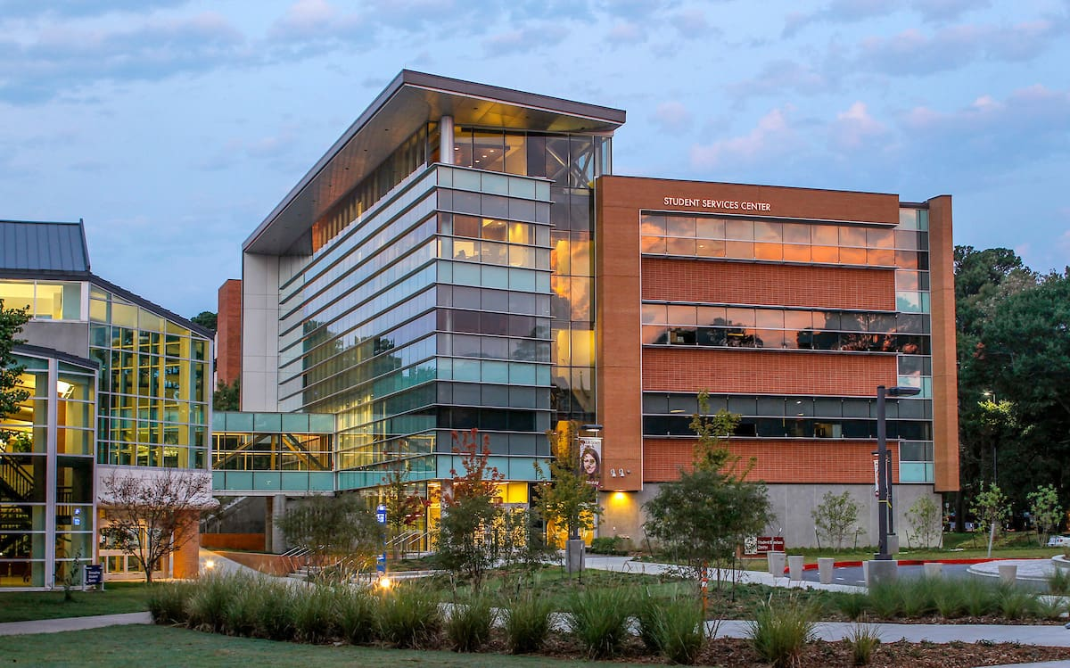
Dr. Christina S. Drale, Chancellor
University of Arkansas at Little Rock

Slide 4
Approval of Minutes
October 24 Regular Meeting
Agenda Item No. 2

Slide 5
Dr. Jim Carr AHECB Chair
AGENDA ITEM NO. 3: REPORT OF NOMINATING COMMITTEE

Slide 6
REPORT OF NOMINATING COMMITTEE
The Nominating Committee (Lucas Pointer, Dr. Katherine Dudley and Carolyn Rhinehart) will make a recommendation on the slate of Board officers for 2026-27, and the Board will act upon the recommendation.

Slide 7
Chair, Dr. Jim Carr
Vice-Chair, Lucas Pointer
Secretary, Dr. Katherine Dudley

Slide 8
Dr. Ken Warden Commissioner
AGENDA ITEM NO. 4: REIMBURSEMENT OF EXPENSES
FOR AHECB AND ICAC

Slide 9
Although members of the AHECB and ICAC by law serve without compensation, they may receive expense reimbursement for performing official board duties after following certain procedures set out by Act 1211 of 1995 (A.C.A. §25-16-901 et seq.).
Because Act 1211 of 1995 (A.C.A. §25-16-901 et seq.) is the sole authority for expense reimbursement, it is necessary for the Coordinating Board to adopt a resolution authorizing expense reimbursement for board members and members of the ICAC.

Slide 10
Dr. Ken Warden Commissioner
AGENDA ITEM NO. 5: COMMISSIONER’S REPORT

Slide 11
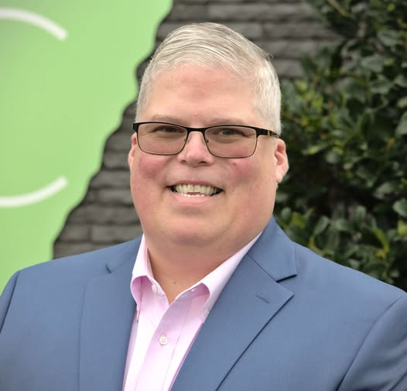

Dr. Ricky Tompkins
UA Hope-Texarkana, Chancellor

Slide 12
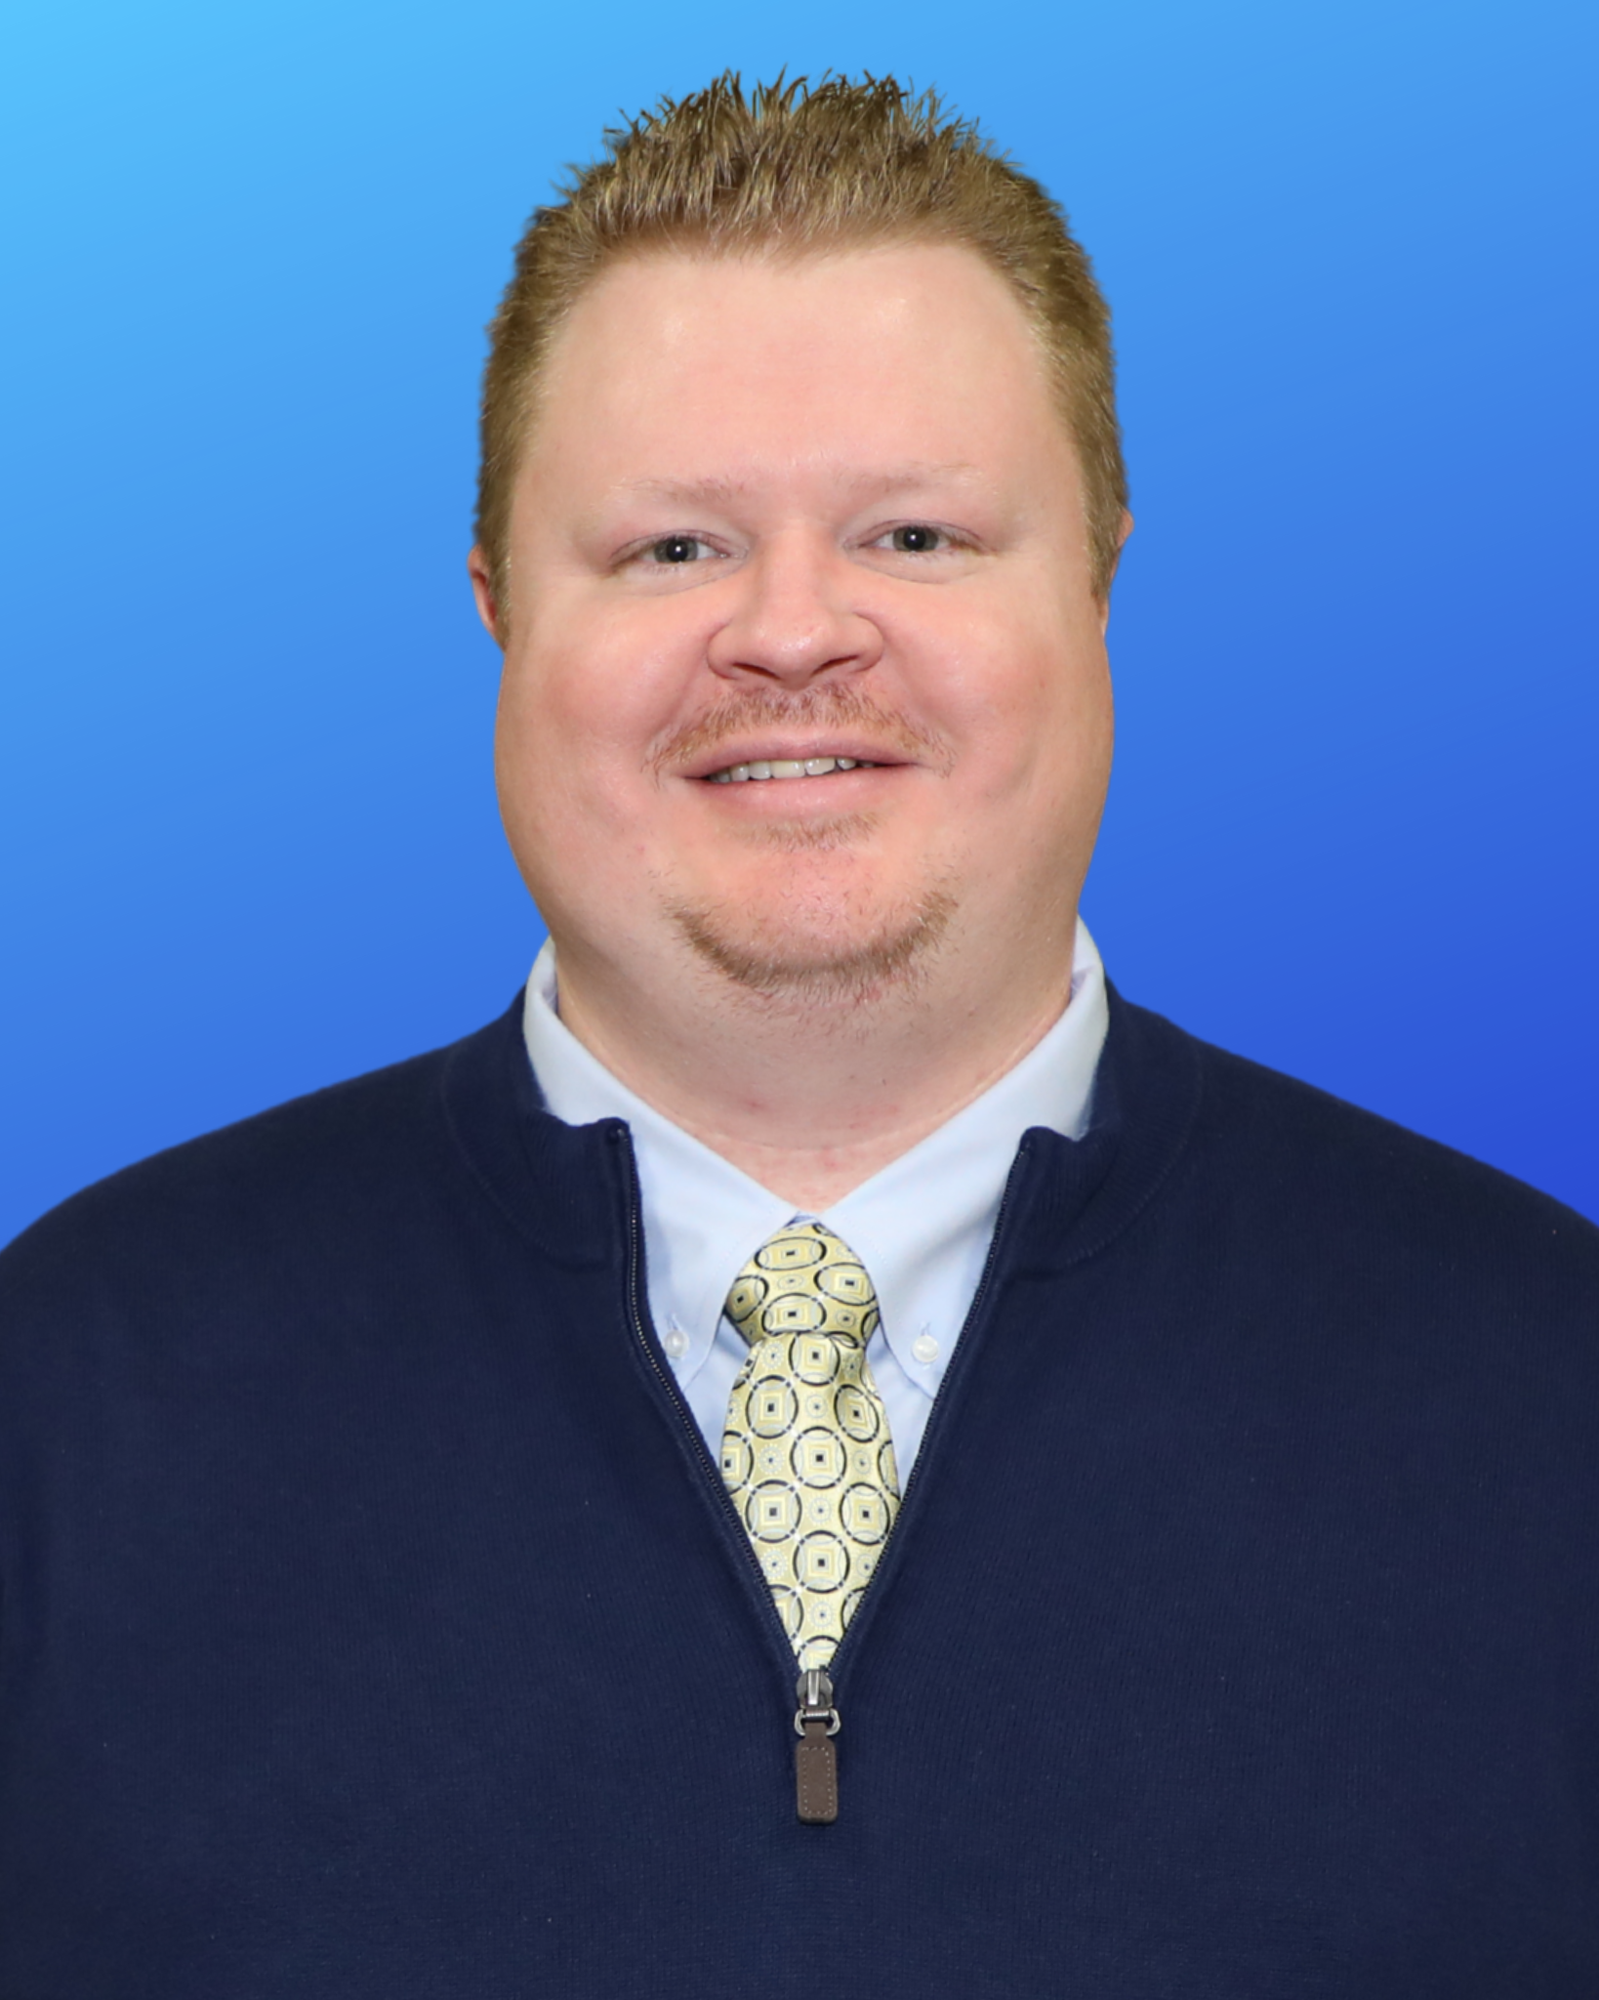
New DHE Staff
Jason Kunau
Finance Controller

Slide 13

Director Tony Williams

Slide 14



Since 1977, ASLA has provided
College Planning Services to thousands of families and
over $1 Billion in Higher Education Funding.
A Division of the Arkansas Development Finance Authority

Slide 15

57,500 Booklets Printed Annually & Available Online Distributed to students through high school counselors Spanish Version - available online

Slide 16
Federal Student Loan Defaults
ASLA is in partnership with 22 Higher Education Institutions to provide student loan default prevention counseling.
COVID Payment Pause: March 2020 to September 2024
Student loan payments NOT required for 4 ½ years.
Loans Entering Repayment | Default Rate Published | Default Rate / Anticipated Rate
2020 | 2023 | 0%
2021 | 2024 | 0%
2022 | 2025 | 0%
2023 | 2026 | 0% or near 0%
2024 | 2027 | Abbreviated Tracking Period = Lower Default Rates?
2025 | 2028 | Return to “Normal”

Slide 17
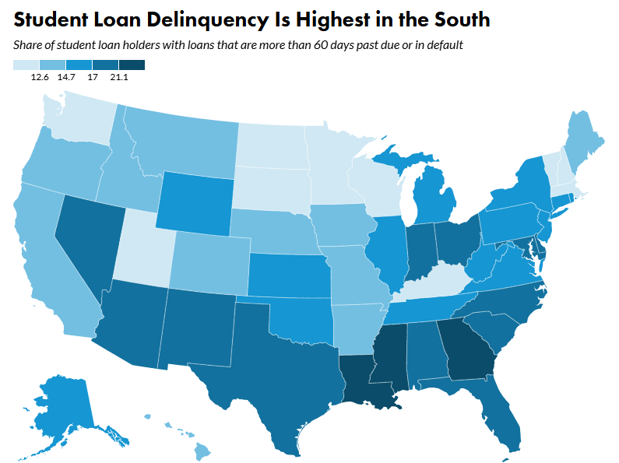
Urban Institute – November 20, 2025
13.5
15.2
15.5
13.1
22.3
18.3
22.6

Slide 18
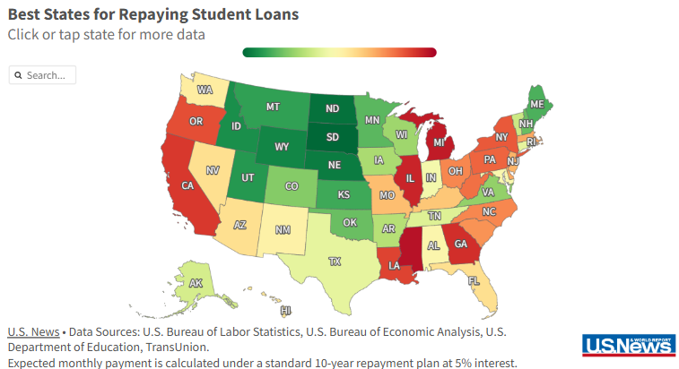
Arkansas ranked 17th Best State at Repaying Student Loans in U.S. News & World Report – September 25, 2025

Slide 19

Student Loan Debt Statistics
Total Federal Student Loan Debt July 2025
Arkansas: $13.8 Billion
Federal Student Loan Originations Academic Year 2024-25
United States: $88,691,000,000
Arkansas: $631,906,373*
Private Student Loans in Arkansas
Annual Volume (estimated): $65-$75,000,000
United States: $1.66 Trillion
Total Outstanding Balance (est.): $1.2 Billion

Slide 20
Average FEDERAL Student Loan Debt Per Borrower July 2025
United States: $37,718
State of Arkansas: $34,024
405,600 Borrowers
13% of AR Residents
Private Student Loan Debt not included in above numbers.

Slide 21
Federal Student Loan Volume 2024-25 Academic Year – Top 12 in Loan Volume
University of Arkansas - Fayetteville | $124,334,398
Arkansas State University - Jonesboro | $99,874,271
Arkansas Colleges of Health Education | $49,245,269
University of Arkansas – Medical Sciences | $48,814,412
University of Central Arkansas | $39,442,324
University of Arkansas – Little Rock | $37,984,498
Harding University | $34,290,874
Univ. of AR – Pulaski Technical College | $18,779,464
Arkansas Tech University | $18,357,534
U of A Grantham Online | $15,084,999
Southern Arkansas University | $13,391,781
University of Arkansas - Monticello | $11,866,941

Slide 22
Available Student Loan Options
Federal Direct Loans | Interest Rate | Origination Fee
Undergrad Subsidized and Unsub | 6.39% | 1.06%
Graduate & Profess. Unsub | 7.94% | 1.06%
Parent PLUS / Grad PLUS | 8.94% | 4.23%
Arkansas Student Loan Authority | Interest Rate | Origination Fee
Student Loans | 2.95% - 6.42% | 0%
Family/Parent Loans | 2.95% - 6.55% | 0%
National For-Profit Lenders | Interest Rate | Origination Fee
Private Student Loans | 2.89% – 17.99% | 0%

Slide 24
One Big Beautiful Bill Act (OB3)
Federal Grad PLUS Program - Phase-out over 3 years
New federal loan borrowers not eligible for Grad PLUS after July 1, 2026
Downfall of program: No annual or aggregate borrowing limits
8.94% interest rate & 4.23% origination fee
Federal Unsubsidized Graduate Loans
New Loan Limits
$20,500 annually for Standard Graduate programs / $100,000 aggregate cap
$50,000 annually for Professional Graduate programs / $200,000 aggregate cap
Federal Parent PLUS Loan (Available to Undergrad Only)
No annual or aggregate loan limits prior to July 1, 2026
Beginning July 1, 2026, Annual Limit $20,000 / Aggregate Limit $65,000
No longer eligible for Income Based Repayment, Standard Repayment only

Slide 25
Federal Direct Student Loan Volume by Loan Type Loans Made Through Arkansas Higher Education Institutions – Award Year 2024-25

Slide 26
Federal Grad PLUS Loan Volume – AY 2024-25 $61,408,334
PUBLIC INSTITUTIONS
University of AR for Medical Sciences | $13,089,876
Arkansas State University - Jonesboro | $5,527,409
University of AR - Little Rock | $4,635,502
University of Central Arkansas | $3,063,462
University of AR - Fayetteville | $2,356,683
Southern Arkansas University | $627,849
Henderson State University | $478,837
Arkansas Tech University | $278,680
University of AR - Monticello | $214,727
University of AR - Grantham | $51,625
University of AR - Fort Smith | $14,641
PRIVATE INSTITUTIONS
AR Colleges of Health Education | $21,906,058
Harding University | $6,135,625
Lyon College | $2,915,061
John Brown University | $61,096
Hendrix College | $37,188
Philander Smith College | $14,015
NYIT College of Osteopathic Medicine Grad PLUS = $17,789,258
Grand Total: $79,197,592

Slide 27
ASLA’s Response to Federal Grad PLUS Elimination
For grad students needing to borrow more than the Federal Unsubsidized Grad Loan annual maximums of $20,500 (Standard Grad) or $50,000 (Professional Grad):
OPTION I
Encourage students to apply for existing Private Student Loans
ASLA requires:
ASLA requires Student or Cosigner to be credit-worthy
660 FICO Score, Debt-to-Income 50% requirement
Student will receive lower rate than Federal Grad PLUS
OPTION II
ASLA hopes to announce a “No-Cosigner” loan by March 2026 for certain fields of study
Credit underwriting based on:
Credit Score
Debt-to-Income Ratio(based on expected future income)
Graduation Rate
Placement Rate

Slide 28
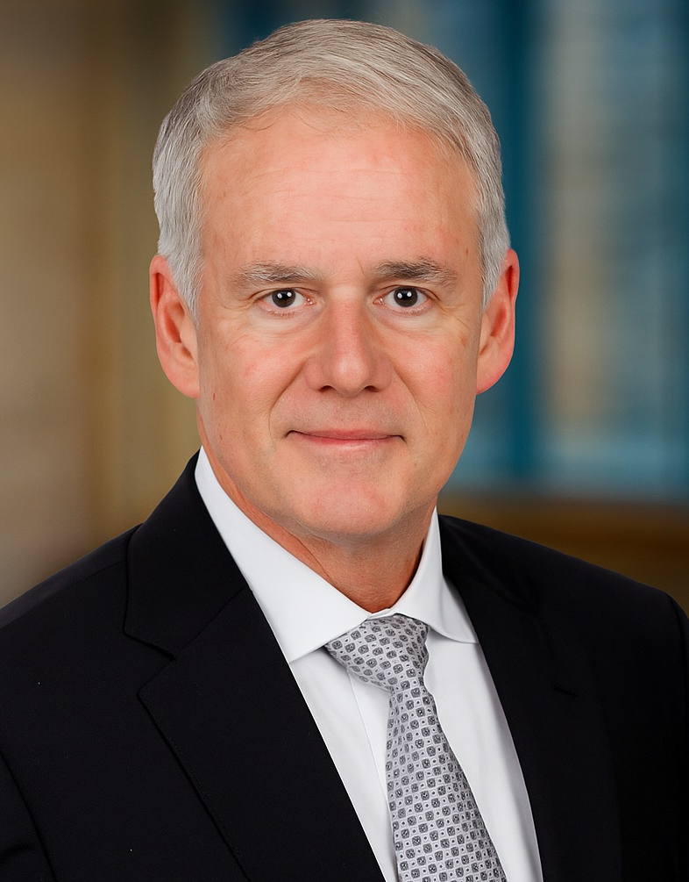


Lt. Gen. (Retired)
Jay B. Silveria
jsilveria@uasys.edu
President, UA System

Slide 29

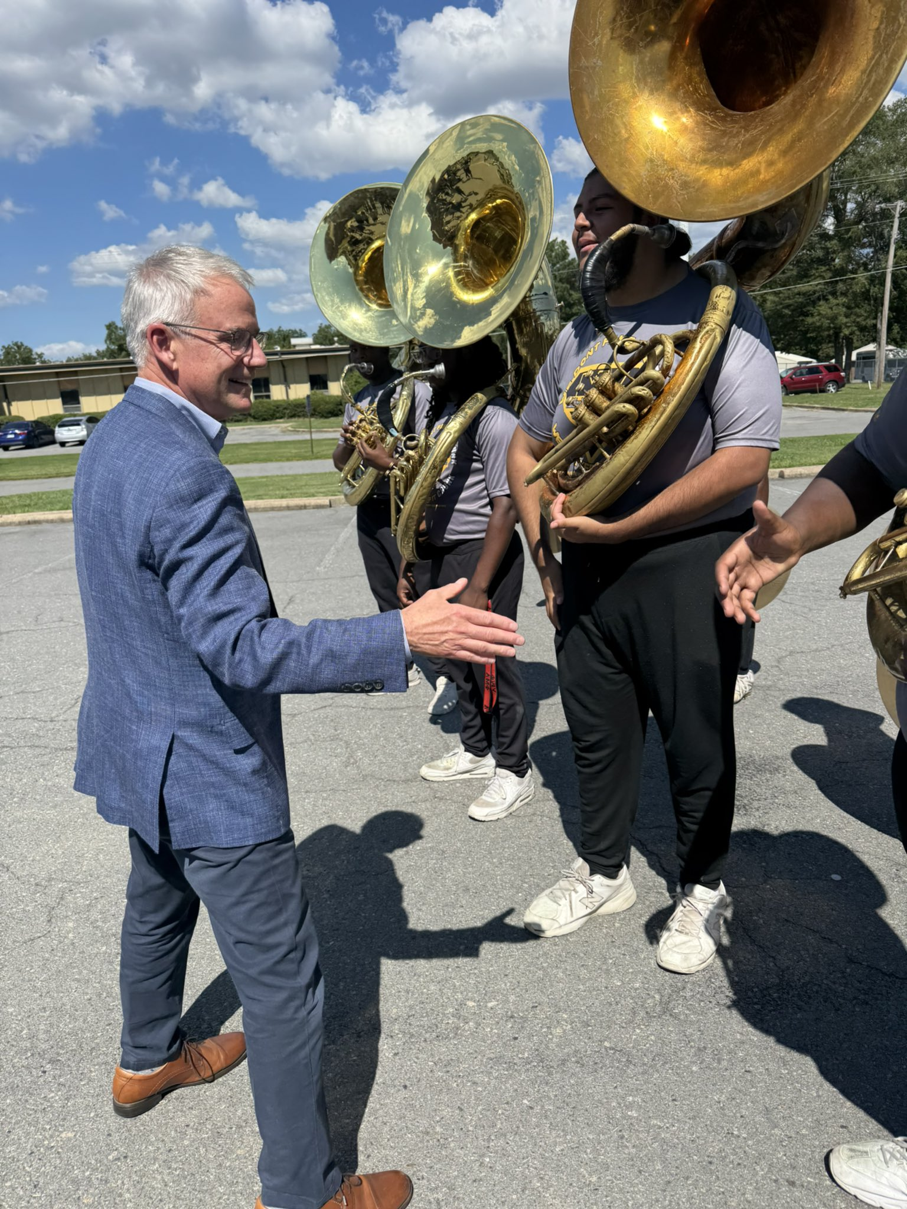
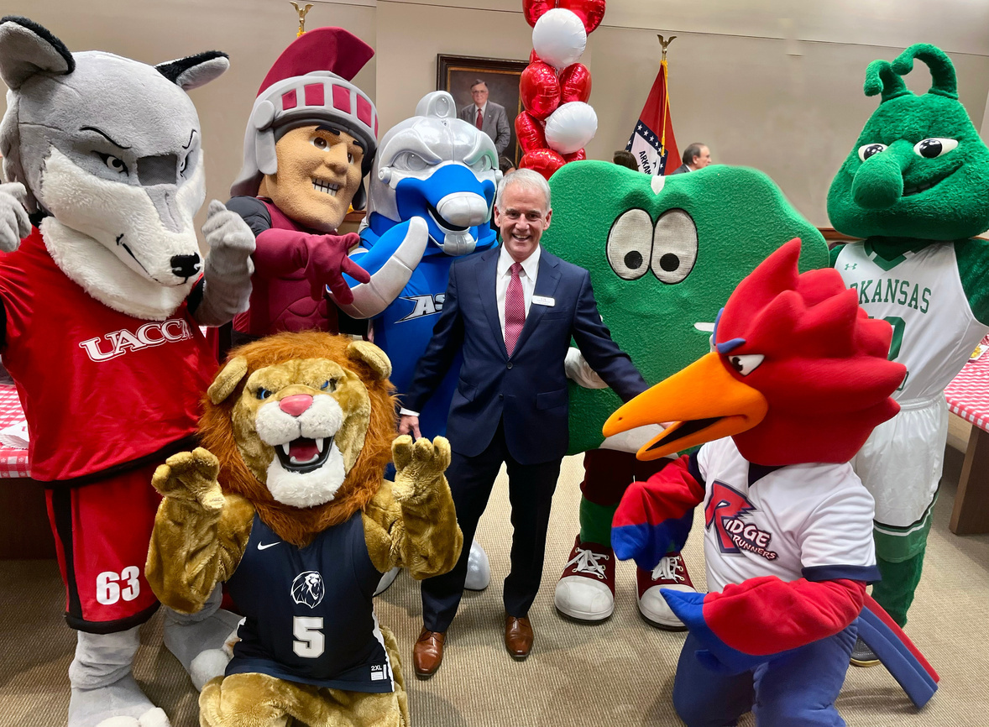
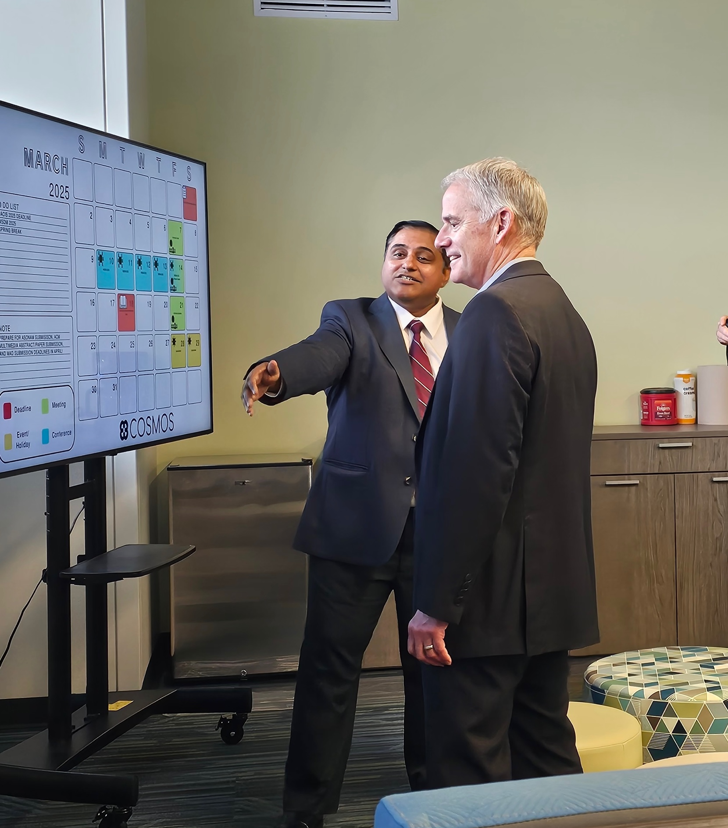
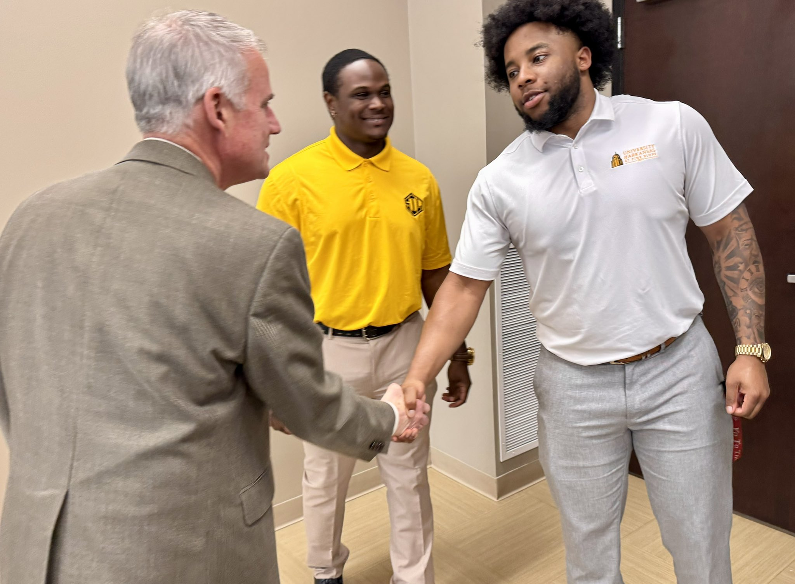
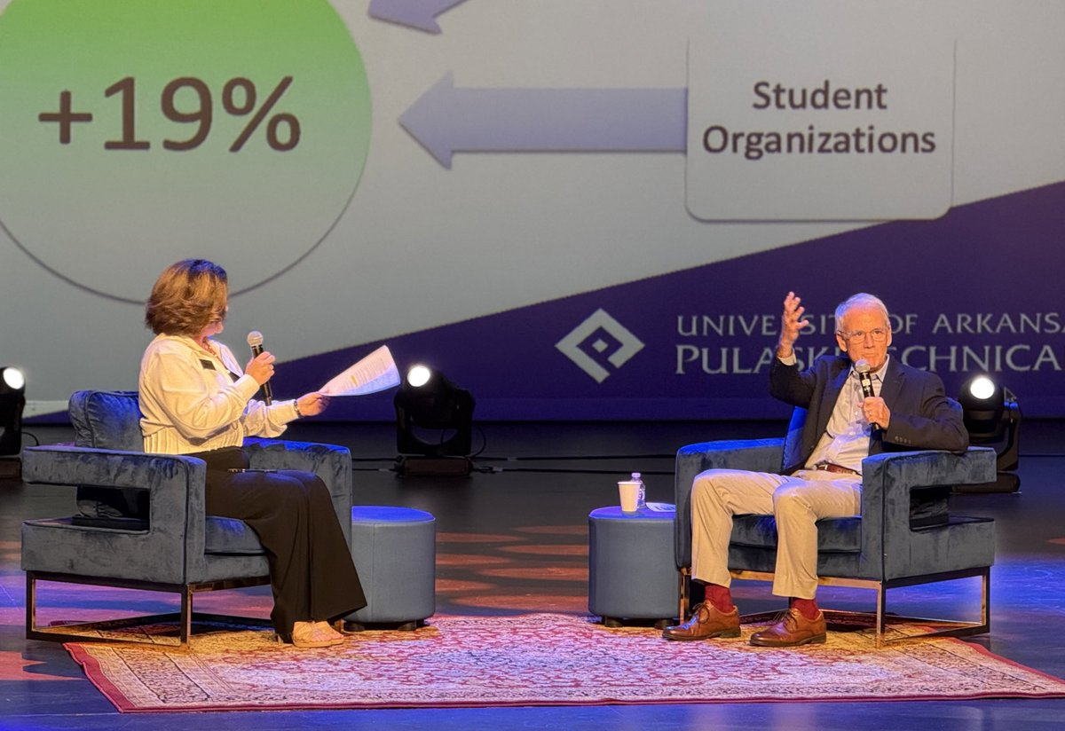

Slide 30










UA, Fayetteville
North Arkansas College*
UA Fort Smith
UA Batesville
Comprised of 21 (soon to be 22*) campuses, divisions and units statewide
Rockefeller Inst.
UA Morrilton
UA Rich Mtn.
UA Little Rock
UA EACC
UADA has a presence in every county
Clinton School
PCCUA-Stuttgart
CCCUA DeQueen
UA-PTC
Other hidden gems within the UA System include Garvan Gardens, the Criminal Justice Institute, Archeological Survey, ASMSA (nationally renowned residential high school)
UAMS
PCCUA-DeWitt
ASMSA
PCCUA-Helena
UA Pine Bluff
CCCUA Lockesburg
UAM-McGehee
UA Hope
Others:
UA Monticello
UA Grantham
UA Grantham is a 100 percent online institution with students around the globe
UA Texarkana
CJI
UAM-Crosset
Division of Ag
Arch. Survey

Slide 31


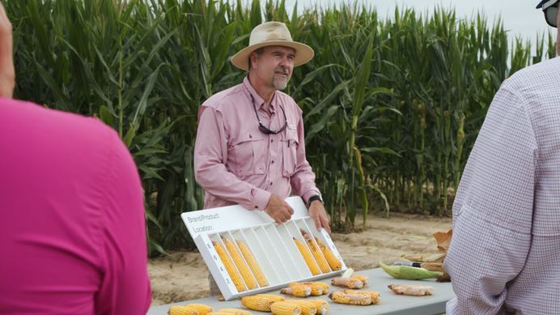


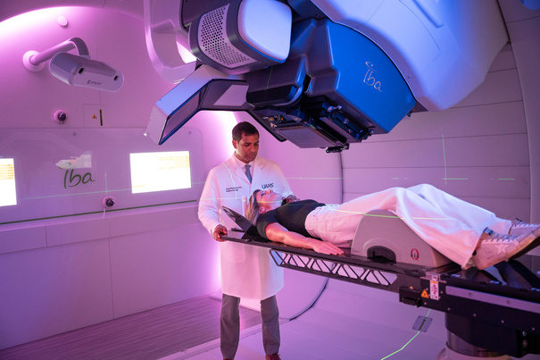



UA System manages a total systemwide budget of more than $4.2 billion
UA System employs nearly 27,000 Arkansans
UA System benefits plan covers more than 35,000
UA System enrolls nearly 70,000 students
Institutions have awarded more than 100,000 degrees and certificates in the last five
years – ensuring better futures for Arkansans and their communities

Slide 32












Movin’ On Up
Because of the diverse range of offerings in the UA System, a student can go from earning a high school diploma to the top level of attainment.
$5
Doctoral Degrees and
Professional Education
Billion
Master’s
Degrees
Estimated annual return on $500 million state investment through degrees and certificates produced by UA System schools
Continuing
Education
$375 Million
$8 OF EVERY $10
Bachelors
Degrees
in annual research expenditures across the UA System
spent at UA System institutions goes toward:
Associate’s
Degrees
INSTRUCTION
RESEARCH
Technical
Certificates
PUBLIC SERVICE
SCHOLARSHIPS
Certificates of
Proficiency
STUDENT SERVICES
High School
Diplomas

Slide 33


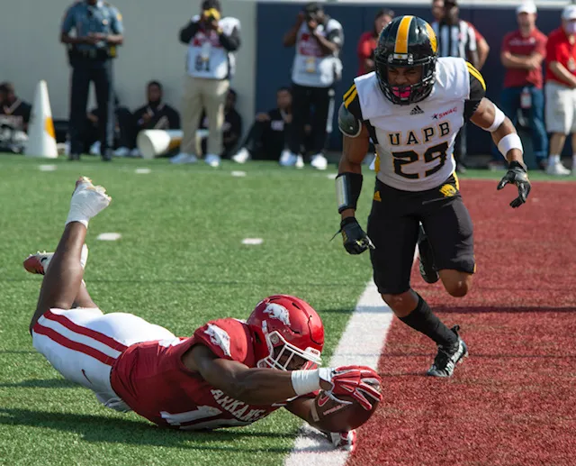
Common Challenges
Demographic headwinds
Expected downward pressure to continue through 2029
Research Funding
Changes on indirect cost reimbursement
Intercollegiate athletics
NIL evolving landscape
The ROI of Going to College
Future students/parents must know college is a worthwhile journey

Slide 34

The Mission of the UA System
Revised Mission Statement
The University of Arkansas System is a publicly supported, multi-campus institution committed to advancing Arkansas through education, scholarship, and service. Rooted in the land-grant tradition, the UA System expands access to academic, practical, and professional opportunities, fosters intellectual growth and student success, promotes discovery and public service, and strengthens Arkansas’s economy, health, and culture. It remains focused on continuous improvement through resource stewardship, statewide responsiveness, and strategic collaboration across its campuses, divisions, and units.

Slide 35
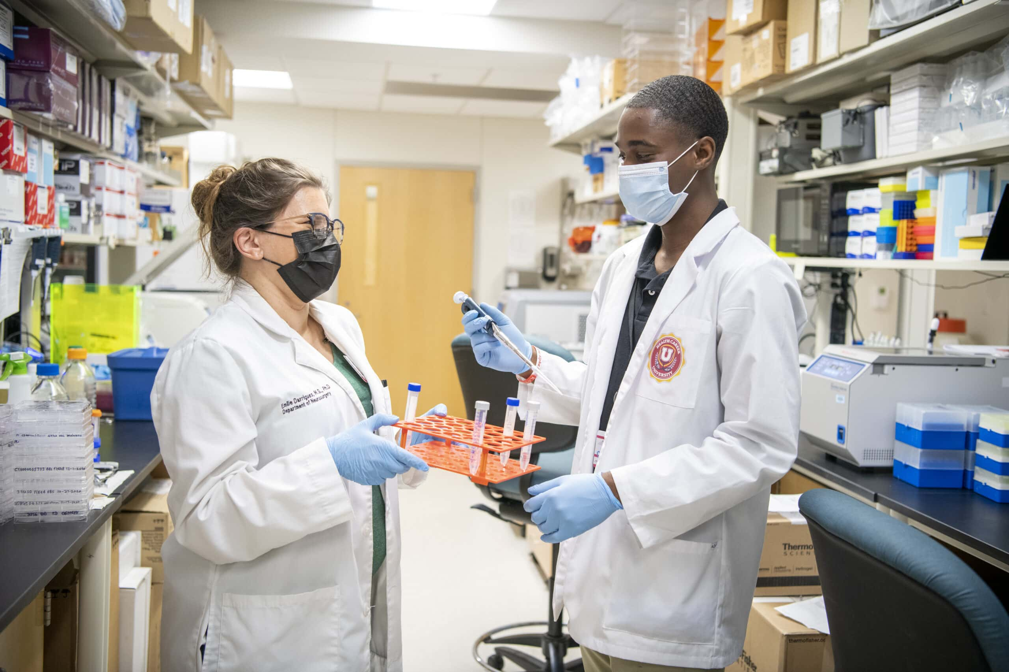

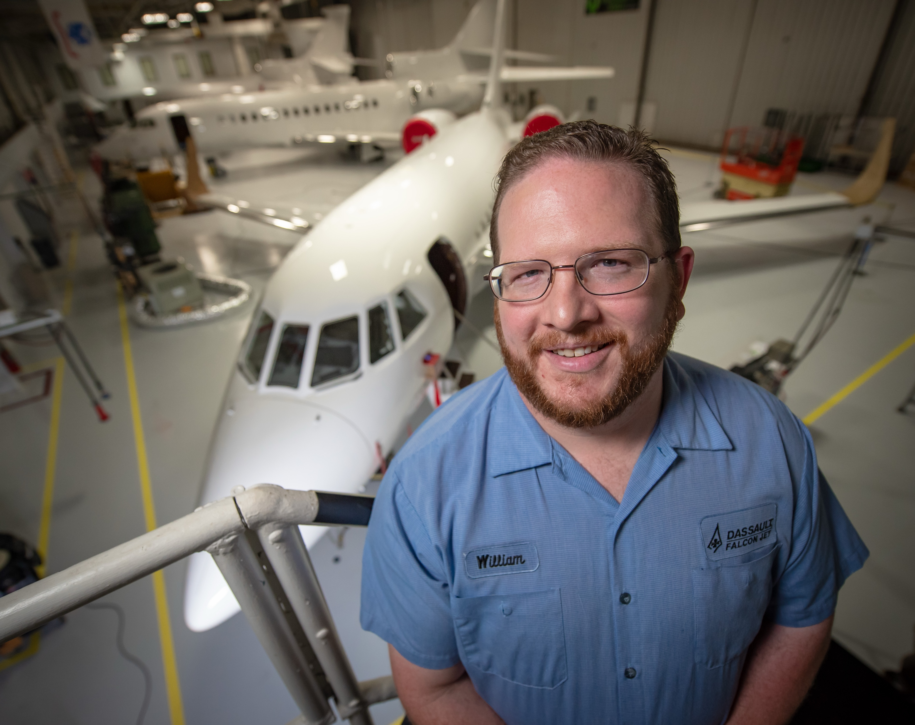

UA System Strategic Pillars
Six Pillars
Pillar 1: Expanded Access to High-Quality, Diverse Educational Opportunities
Pillar 2: A Systemwide Commitment to Student Success
Pillar 3: Advancing Scholarship, Innovation and Discovery
Pillar 4: Stewardship of Talent, Resources, and Public Trust
Pillar 5: Responsiveness to Statewide Needs and Priorities
Pillar 6: Collaboration and Integration through Technology and Business Innovation

Slide 36























COMING SOON

Slide 37

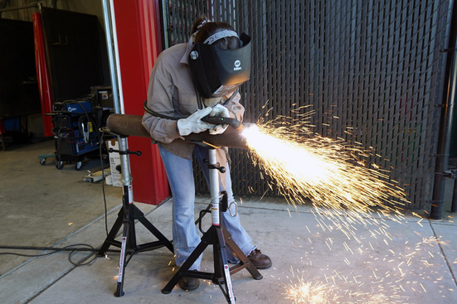





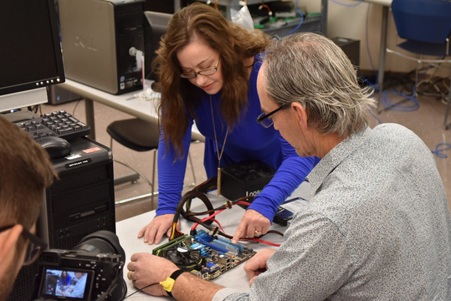
jsilveria@uasys.edu
www.uasys.edu

Slide 38
Alana Colburn
Associate Director of
Private Postsecondary Education

Slide 39
ICAC Oversight
The Institutional Certification Advisory Committee is mandated by Arkansas law and is appointed by the Commissioner of ADHE.
ICAC has oversight of out-of-state postsecondary institutions that are not in the State Authorization Reciprocity Agreements (SARA) and Arkansas private institutions.
Institutions exempt from ICAC oversight:
Church-related training
Institutions on military bases
Institutions in regional and national reciprocity agreements (like SARA)

Slide 40
Out-of-State and Arkansas Private Institutions
2024-25: 44 Institutions
8 Arkansas Campuses
36 Institutions with programs delivered only through distance technology to Arkansas students
5 Institutions offering programs both on Arkansas campuses and delivered through distance technology
3 Institutions offering programs only on an Arkansas campus

Slide 41
Degrees Offered
July 1, 2024 – June 30, 2025
Type of Degree | Number of degrees offered
Undergraduate | 289
Graduate | 538
Total | 827
ADHE did not see a substantial increase in programs were certified from last year and made available for students to enroll.

Slide 42
Student Enrollment and Graduates
July 1, 2024 – June 30, 2025
Online Enrollment – 3,725
Onsite Enrollment – 3,226
Total Enrollment – 6,951
(340 less than last year)
Total Graduates – 1,562
(221 more than last year)

Slide 43
Graduates by Degree
July 1, 2024 – June 30, 2025
Type of Degree | Number of Graduates by Degree Type
Certificates | 392
Associate of Applied Science Degrees | 473
Associate of Arts/Science Degrees | 22
Bachelor’s Degrees | 174
Master’s Degrees | 168
Doctoral Degrees | 333
Total | 1, 562

Slide 44
Institutions Exempt from Certification
31 institutions offering only church-related training (at Arkansas institutions, seminaries, and churches, and online from other states)
2 institutions offering programs on military installations
The majority (51% of total annual enrollment) of students enrolled at the institution located on the military installation must be active or retired military personnel and/or their dependents
Out-of-state institutions approved by state higher education agencies to offer degrees by distance technology through a recognized regional or national education compact such as SARA

Slide 45
State Authorization Reciprocity Agreements (SARA)
ADHE must approve Arkansas colleges and universities offering distance technology programs for SARA participation based on institutional accreditation, financial stability, and student complaint resolution policy and procedures.
38 Arkansas institutions are in SARA; over 2,400 institutions nationwide have joined.
SARA participation is optional for Arkansas institutions.
Applications to ADHE from out-of-state institutions have decreased as more states and institutions have joined SARA.
Every state, Puerto Rico, D.C., and the Virgin Islands has joined SARA except California.
For more information and data on Arkansas enrollments, go to: nc-sara.org/

Slide 46
State Authorization Reciprocity Agreements (SARA)
NC-SARA Data Reporting
The following three slides are from the National Council for State Authorization Reciprocity Agreements.
More information is available from this report including a list of the out-of-state institutions where Arkansans are enrolling and the savings of institutions participating in SARA.

Slide 47
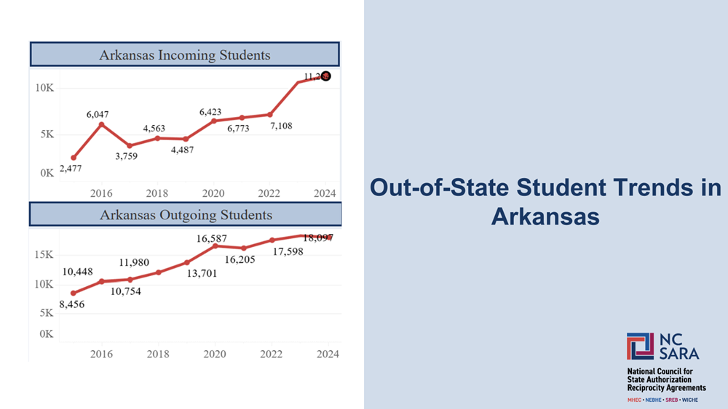
State Authorization Reciprocity Agreements (SARA)

Slide 48
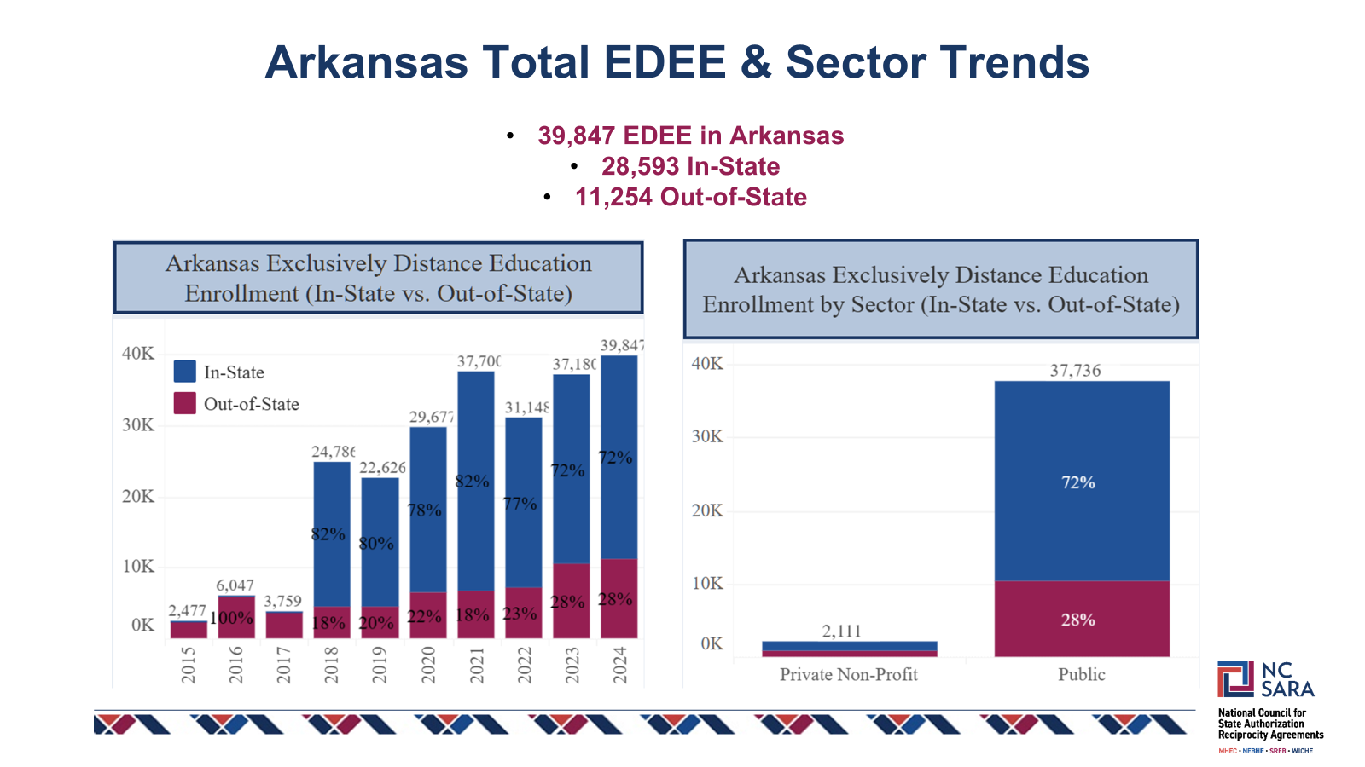
Fall 2024 Exclusively Distance Education Enrollment (EDEE)

Slide 49
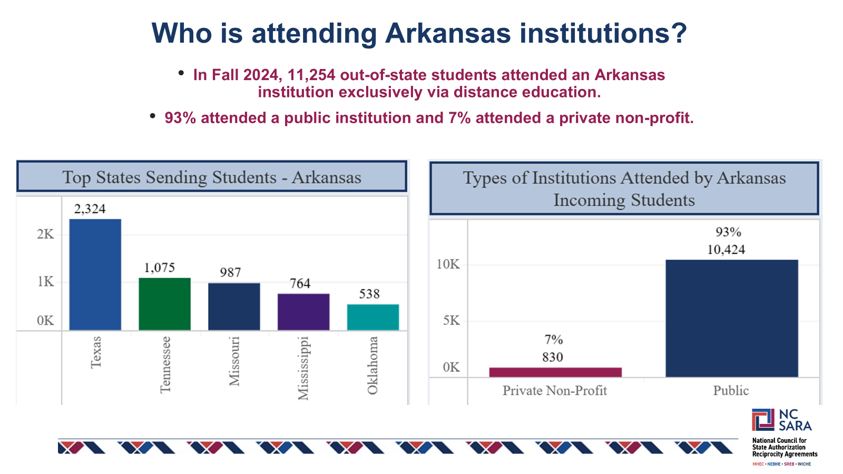

Slide 50
AGENDA ITEM NO. 8: PROGRAM VIABILITY REPORT
Mason Campbell
Assistant Commissioner of Academic Affairs

Slide 51
Academic Program Viability Standards
AHECB adopted new program viability standards in October 2008.
The 2008 viability standards, based on a 3-year average, are as follows:
Average of four (4) graduates per year for CTE degrees and certificates
Average of four (4) graduates per year for bachelor’s degrees in science, mathematics, engineering, foreign languages, and secondary education
Average of six (6) graduates per year for transfer associate degrees (AA, AS, and AAT) and bachelor’s programs;
Average of four (4) graduates per year for master’s, specialist and first-professional programs; and,
Average of two (2) graduates per year for doctoral programs

Slide 52
Academic Years for AY25 Non-Viable Report
The graphic below illustrates how the academic years are considered for this report:
AY2023 | AY2024 | AY2025
AY2022 | AY2023 | AY2024
AY2021 | AY2022 | AY2023
Programs considered for deletion at the January 2026 Board Meeting were also identified as non-viable for two (2) additional three-year averages.
Initial viability is established based on a three-year average of
AY21, AY22, and AY23.

Slide 53
Non-Viable Programs by Award Type
Award Type | Number
Certificate of Proficiency | 74
Technical Certificate | 40
Associate Degrees | 39
Bachelor’s Degrees | 37
Master’s Degrees | 15
Graduate Certificate Degrees | 7
Doctoral Degrees | 1
Total | 213
Of the 213 non-viable programs:
1 Program was inactivated
8 Programs were deleted by institutions

Slide 54
Non-Viable Programs by Award Type

Slide 55

Non-Viable Programs Report Conclusion
Institutions worked diligently to address non-viable programs
Formal call for comment period
ADHE prescribed Zoom discussions
Recent revision of the Policy for the Approval or Revision of Academic Programs and Organizational Units
Refined new program policy for clarity of recently approved programs, as it relates to program viability and program reactivations
All remaining programs considered as non-viable and have no ADHE approved justification, will be removed from active status on the approved programs list effective by May 1, 2026, unless otherwise noted.
ADHE staff will monitor process made on each institutional commitment.

Slide 56
Questions?

Slide 57
Annual Fall Enrollment Report
AHECB Meeting
January 23, 2026
Sonia Hazelwood Assistant Commissioner

Slide 58
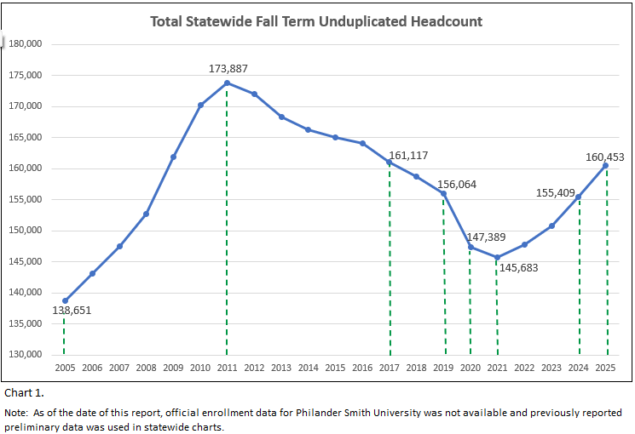
Statewide Fall Term Headcount
The total unduplicated headcount for the fall 2025 term in all sectors of Arkansas higher education, including public 4-year universities, public 2-year colleges, private and independent colleges and universities, two nursing schools, and one technical institute was 160,453 students.
The fall 2025 statewide headcount reported a 3.2% increase over fall 2024 and an almost 9% increase over the fall 2020.
The fall 2025 statewide headcount of 160,453, finally surpassed the pre-pandemic fall 2019 headcount of 156,064.
The fall 2025 statewide headcount was the highest fall term headcount since fall 2017.

Slide 59
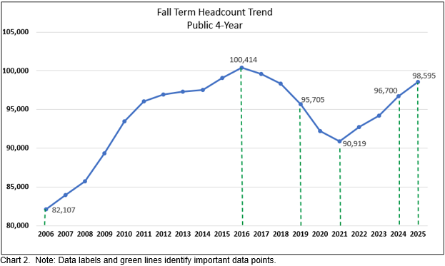
Fall Term Headcount Public 4-Year
As highlighted in chart 2, the public 4-year institutions surpassed the pre-pandemic fall 2019 headcount of 95,705 in fall 2024 and continued with a solid 2% increase for the fall 2025 term.
This increase in fall term headcount for the public 4-year institutions is due to increases in both high school student and undergraduate student enrollments.
The public 4-year universities traditionally enroll 61-62% of the statewide total fall term headcount.

Slide 60
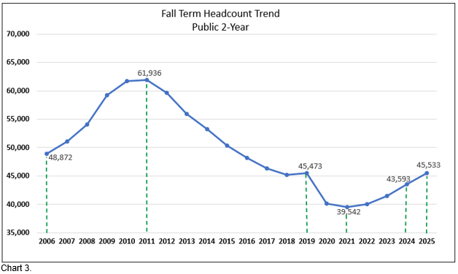
Fall Term Headcount Public 2-Year
The public 2-year colleges showed a 4.5% increase for fall 2025 reporting 45,533 students, which was just enough to surpass the fall 2019 pre-pandemic headcount of 45,473
This increase in fall 2025 headcount for the public 2-year colleges is due mostly to an increase in high school student enrollment for 18 out of 22 Arkansas 2-year colleges.
The public 2-year colleges enroll 27-28% of the statewide total fall term headcount.

Slide 61
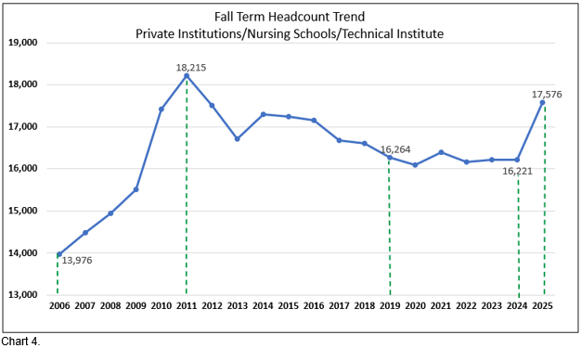
Fall Term Headcount Private Institutions, Nursing Schools & Technical Institute
Private/independent colleges and universities, including two nursing schools and a technical institute, were not impacted by the Covid-19 pandemic as the public institutions were, as their fall term headcount remained around 16,000 between fall 2019 and fall 2024.
Fall 2025 showed a considerable increase in headcount of more than 8% due to several institutions reporting increases.

Slide 62
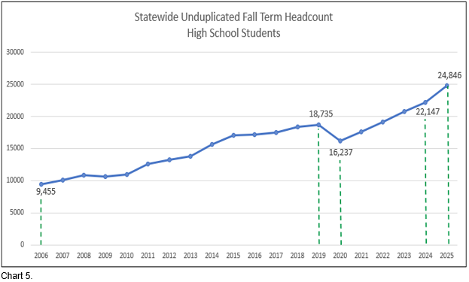
Statewide Fall Term Headcount High School Students
Statewide high school student headcount for fall 2025 was 24,846, which increased from last year by almost 2,700 students. This is a 12.2% increase. This represents the largest high school student fall term headcount.
Dually enrolled students, those taking college courses for college credit only, represent less than 1% of the total high school student enrollment.
The rise in high school student headcount should continue to increase due to the focus the ACCESS law puts on providing high school students with more options and better-informed workforce pathways provided by taking concurrent classes.
ACCESS also offers incentives for better scholarship opportunities through receiving diplomas of merit and distinction.

Slide 63
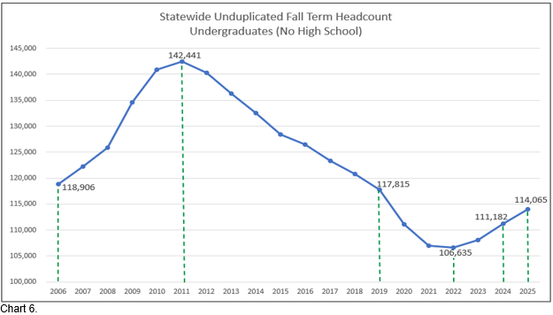
Statewide Fall Term Headcount Other Undergraduates (No High School)
Other undergraduates have yet to surpass the pre-pandemic fall 2019 headcount of 117,815 but has shown solid growth in the past three fall terms, recovering from a low fall term headcount in fall 2022 of 106,635.
Statewide undergraduate headcount increased 2.6% to 114,065.

Slide 64
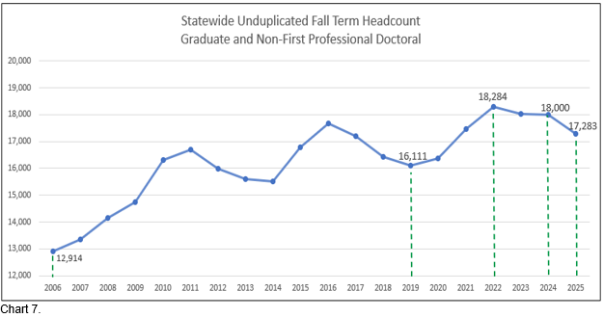
Statewide Fall Term Headcount Graduate and Non-First Professional Doctoral
Graduate and Non-First Professional Doctoral headcount declined in fall 2025 by almost 4%.

Slide 65
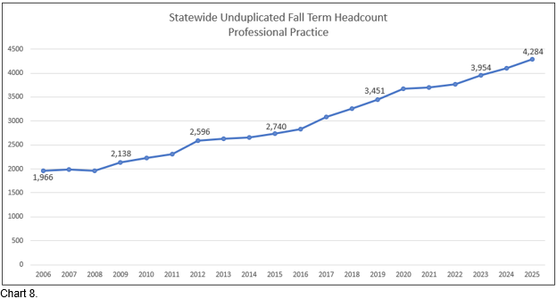
Statewide Fall Term Headcount First Professional/Doctoral
First-professional headcount has shown gradual growth for the past 20 years.
Fall 2025 reported a 4.5% increase over fall 2024
Headcount includes students in law, medicine, pharmacy, advanced nursing programs, and occupational and physical therapies.

Slide 66
Annual College-Going Rate Report
AHECB Meeting
January 23, 2026
Sonia Hazelwood Assistant Commissioner

Slide 67
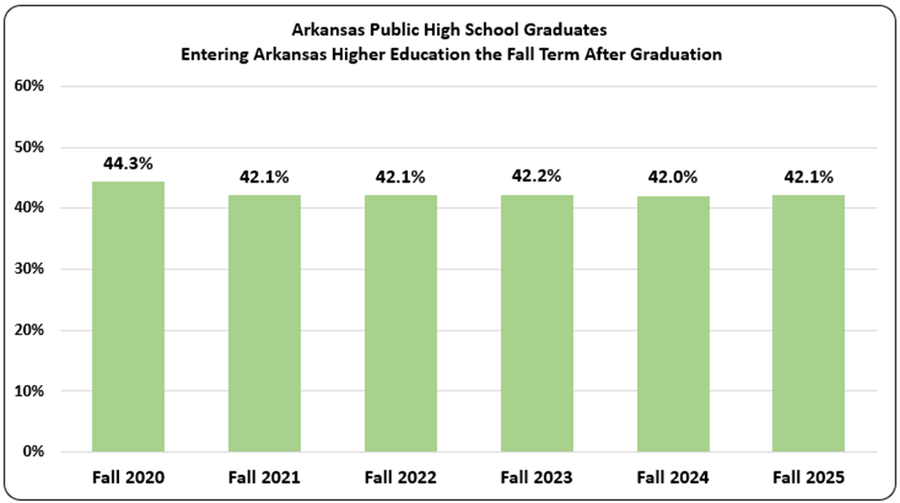
College-Going Rate Trend
ADHE received 2025 public high school graduate data from DESE and combined it with fall 2025 data submitted to ADHE from all Arkansas public and private institutions. The College-Going Rate calculations include only students graduating from an Arkansas Public High School or Public Charter High School.
Of the 35,057 public high school students graduating from an Arkansas public high school in 2025, 14,762 enrolled at an Arkansas public or private/independent institution in fall 2025 immediately following their high school graduation.
This represents a College-Going Rate of 42.1%, which is consistent with the 42% reported since the fall 2021 term.

Slide 68
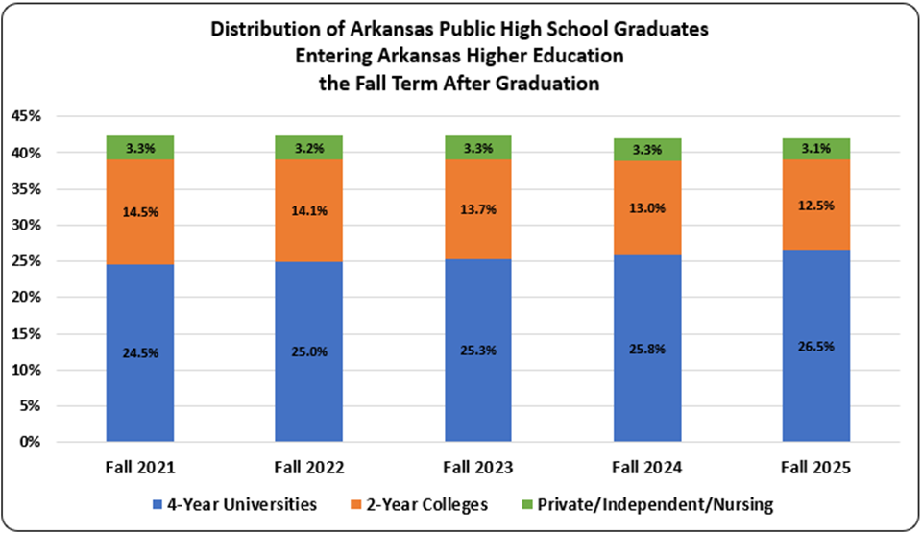
College-Going Rate Trend
The share of students entering college immediately after high school graduation, who enrolled in college at the public 4-year universities grew to 26.5% for fall 2025, which is a slight increase.
The share of enrolled students at the public 2-year colleges declined 0.5% to 12.5%, while the share of students attending our private/independent institutions also reported a slight decline.

Slide 69
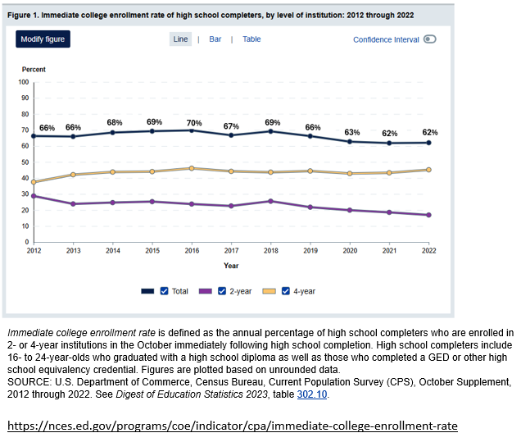
NCES Immediate College Enrollment Trend
The last published update to the NCES Immediate College Enrollment Rate was in May 2024 for the 2022 high school completers. There are differences in the methodologies used by NCES and the methodology used in calculating the Arkansas College-Going Rate.
The NCES rate is not a calculated rate based on an actual data match, but an estimated rate using several data sources, including a Current Population Survey administered by the Census Bureau.
NCES includes high school graduates from both public high schools and private high schools.
It includes GED and other high school equivalency completers.
It includes students enrolled in any institution and online institution programs.

Slide 70
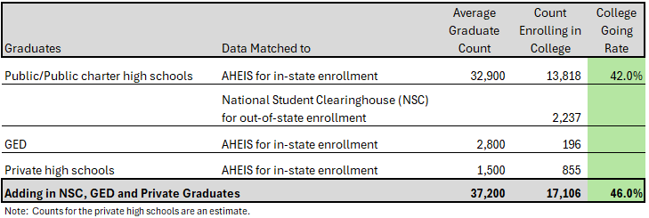
Working Toward a More Complete Arkansas Rate
As the value of higher education is in question, it is important that the College-Going Rate reported each year includes all possible data points. The following chart shows how an expanded college-going rate would look. Counts provided in the chart are multi-year averages or educated estimates.
ADE/AHEIS – Actual data match using ADE graduates and AHEIS which provides the current College Going Rate.
National Student Clearinghouse (NSC) – Data match using ADE graduates with the NSC database for out-of-state college attendance.
GED Recipients – Data match of GED recipients available in the state longitudinal data system with AHEIS.
Private High School Graduates – An educated estimate using available resources including ADE, NCES, and AHEIS data.

Slide 71
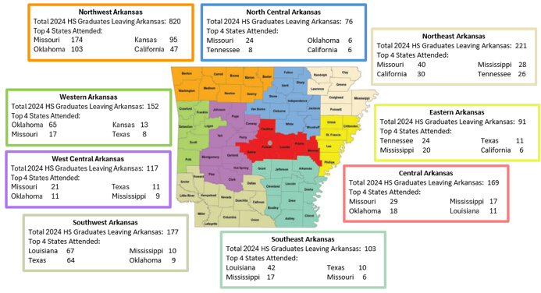
Arkansas Public High School Graduates Attending Out-of-State Institutions
Source: National Student Clearinghouse

Slide 72
Nick Fuller Assistant Commissioner
AGENDA ITEM NO. 11: Annual Financial Conditions Report

Slide 73
Introduction
Report Purpose:
Describe financial conditions of Arkansas’s Public Institutions of Higher Education
Describe challenges experienced by Arkansas’s Public Institutions of Higher Education
Topics Addressed:
Productivity-Based Funding
Comparison of Arkansas faculty salaries to other SREB states
Tuition & Fees
Fund Balances
Institutional Scholarship Expenditures
Athletic Expenditures

Slide 74
Comparison of Arkansas Faculty Salaries to other SREB states

Slide 75
Comparison of Arkansas Faculty Salaries to other SREB states

Slide 76
Comparison of Change in Funds per FTE Students to other SREB states - Universities

Slide 77
Comparison of Change in Funds per FTE Students to other SREB states - Colleges

Slide 78
Tuition and Fees
With the Governor’s addition of roughly $40,000,000 in State funding for higher education since the implementation of the Productivity Funding model in fiscal year 2018-19, institutions have been tasked with trying to limit tuition increases as to keep costs to students as affordable as possible.
Even with these efforts, tuition and fee increases were needed at institutions causing total Tuition and Fee changes from 2024-25 to 2025-26 to reflect the following:
Four-year Institutions = 1-YR Average increase 3.3%
Two-year Institutions = 1-YR Average increase 3.9%

Slide 79
Tuition Increases – 4 Year Institutions

Slide 80
Tuition Increases – 2 Year Institutions

Slide 81
Fund Balances
According to industry standards, optimal fund balances should range from 5% to 14% of the E & G operating budget.
For 2024-25, all but three of the 4-year institutions’ fund balances were above 5%.
For 2024-25, no 2-year institution’s fund balance fell below 5%.

Slide 82
Fund Balances – 4-Year

Slide 83
Fund Balances – 2-Year

Slide 84
Institutional Scholarships (Academic and Performance)
A.C.A 6-80-106 set limitations on Institutional Scholarships from tuition and fees
Academic and Performance scholarships awarded to students who qualify for a Pell Grant were excluded in accordance with A.C.A. § 6-80-106.
The limit is 20% of E&G tuition and fee revenue
21,909 scholarships were awarded at 4-Year Institutions at a cost of $67.6 million compared to 20,502 at a cost of $72.7 million the previous year
Scholarships as a percent of tuition and fees were 7.6% compared to 8.6% the previous year

Slide 85
Institutional Scholarships

Slide 86
Other Thoughts
Capital Funding
The Facilities Audit Program reported the replacement values for E&G facilities as $5.3 billion. The E&G maintenance needs as of 2024 show that the institutions have $3.6 billion in deferred maintenance with $474.05 million of that classified as critical.

Slide 87
Recommendations
Continue to work with institutions to monitor and refine the Productivity Funding Model policies to ensure adequate funding is available to meet student needs, innovation is encouraged, and that the policies continue to respond to attainment goals and priorities of the state.
AHECB, ADHE and institutions of higher education work with the legislature toward alignment of institutional funding policies, state financial aid policies, and tuition policies in a way that prioritizes higher education affordability.

Slide 88
Nick Fuller Assistant Commissioner
AGENDA ITEM NO. 12: Maintenance Report

Slide 89
Maintenance of New Facilities Report
The AHECB policy for maintenance of new facilities states that a report on the amount transferred to plant funds will be presented annually at the AHECB meeting
Ensures all newly constructed or purchased facilities will have a source of funding for maintenance
Institutions seeking approval of a loan or a bond issue for the construction or purchase of a new facility must provide for the maintenance of that facility by transferring annually to plant funds Current rates:
$2.50 per gross square foot for an educational and general facility
$1.25 per gross square foot for an auxiliary facility
Report includes the status of the maintenance transfer for each new facility for which a loan or bond issue was approved for the construction or purchase of that facility

Slide 90
Nick Fuller Assistant Commissioner
AGENDA ITEM NO. 13: OPERATING RECOMMENDATIONS FOR THE 2026-2027 FISCAL YEAR

Slide 91
ADHE Recommendation
Recommendations for State Operating levels are based on Productivity Funding Recommendations as well as current estimates for EETF and WF2000 funding. Non-formula recommendations are based off of 2nd year recommendations approved last year and any new requests submitted to staff.
ADHE is recommending an additional 5% spending authority increase to the funding recommendations within the productivity model to account for any fluctuations with the forecast for special revenues that are included in the State appropriations.

Slide 92
Operating Recommendations

Slide 93
Operating Recommendations

Slide 94
Operating Recommendations

Slide 95
Operating Recommendations

Slide 96
Operating Recommendations

Slide 97
Operating Recommendations

Slide 98
Nick Fuller Assistant Commissioner
AGENDA ITEM NO. 14: Personal Services Recommendations for the 2027 Fiscal Session

Slide 99
Summary of Recommendations
Line-item maximum salary increases were considered for the fiscal year, and all line-item maximums were adjusted by 3.4 percent.
Salary recommendations for new positions were based on salaries for similar positions previously established at comparable institutions.
Institutions have 27,144 positions currently authorized, excluding UAMS.
ADHE Staff recommends an increase of 17 positions for institutions.
Increase of 0.1 percent for a total of 27,161 positions
UAMS did not request to change their currently authorized position total of 12,874.
ADHE Staff recommends continuation of the current level of 12,874 positions.

Slide 100
Nick Fuller Assistant Commissioner
AGENDA ITEM NO. 15: ECONOMIC FEASIBILITY OF A BOND ISSUE FOR SOUTHERN ARKANSAS UNIVERSITY

Slide 101
Relevant Information
$23.775 million with a term of up to thirty (30) years @ a rate of approximately 4.85%
Auxiliary (AUX) purposes
Revenue Funding Source: Housing Revenue

Slide 102
Relevant Information
Proceeds from the bond issue will be used for:
Refunding of the 2015, 2016 and the 2018A series bonds, with no new funds issued. These bonds were secured through a privatized housing agreement with SAUM’s Alumni Association. The existing obligation and the related assets will be transferred to the University.
In Accordance with Board Policy, based on estimated square footage of the facility, $130,155 per year will be transferred into a building maintenance fund.

Slide 103
Nick Fuller Assistant Commissioner
AGENDA ITEM NO. 16: ECONOMIC FEASIBILITY OF A LOAN ISSUE FOR ARKANSAS STATE UNIVERSITY

Slide 104
Relevant Information
$2.5 million with a term of up to ten (10) years @ a rate of approximately 0.2%
Educational and General (E&G) purposes
Revenue Funding Source: Tuition & Fee Revenue

Slide 105
Relevant Information
Proceeds from the bond issue will be used for:
Construction of an Equine Barn and a Bovine Barn, and for the replacement of the Dean B. Ellis Library Chiller at ASU-Jonesboro.
In Accordance with Board Policy, based on estimated square footage of the facility, $20,000 per year will be transferred into a building maintenance fund.

Slide 106
Nick Fuller Assistant Commissioner
AGENDA ITEM NO. 17: ECONOMIC FEASIBILITY OF A BOND ISSUE FOR ARKANSAS STATE UNIVERSITY

Slide 107
Relevant Information
$16 million with a term of up to fifteen (15) years @ a rate of approximately 4.5%
Auxiliary (AUX) purposes
Revenue Funding Source: Housing Revenue

Slide 108
Relevant Information
Proceeds from the bond issue will be used for:
Renovation of Kays Hall.
In Accordance with Board Policy, no additional revenue will be transferred into a building maintenance fund as the renovation will not result in additional square footage to the building.

Slide 109
Mason Campbell
Assistant Commissioner
of Academic Affairs

Slide 110

Arkansas Public Institutions New Program
Technical Certificate and Certificate of Proficiency
in Precision Agriculture
Academic Affairs Agenda Item No. 18

Slide 111

Arkansas Public Institutions New Program
Associate of Applied Science in Farm & Ranch Management
Technical Certificate in Precision Agriculture
Certificate of Proficiency in Agriculture Drone Technology
Academic Affairs Agenda Item No. 19

Slide 112
Tracy Harrell
Chief Program Development Officer
Academic Affairs

Slide 113
Arkansas Public Institutions Letters of Notification
n | Requested Action
9 | Approved Programs List Corrections
9 | CIP Code Change
22 | Curriculum Revision
4 | Deletion of Concentration or Minor
3 | Existing Program Offered by Distance Education
4 | Existing Program Offered at an Existing Off-campus Location
13 | New Certificate or Degree Program
5 | New Concentration or Minor
12 | New Off-Campus Location - Concurrent Education
1 | New Off-Campus Location - Instruction Center
2 | New Organizational Unit
1 | Program Deletion
5 | Program Inactivation
3 | Program Reactivation
1 | Reorganization of Organizational Unit
9 | Title Change
103
21 institutions submitted
Letters of Notification affecting 88
unique programs of study
Received by November 3, 2025
Academic Affairs Agenda Item No. 20

Slide 114
Arkansas Public Institutions Letters of Intent
13 Arkansas public institutions submitted Letters of Intent
Received by January 2, 2026
n | Reason of Intent
1 | New Off-Campus Instruction Center
39 | New Program
40
Academic Affairs Agenda Item No. 21

Slide 115
Alana Colburn
Associate Director of Private Postsecondary Education

Slide 116
Out-of-State Institutions New Programs
Initial Program Certification
Certification to offer the specified degree programs via distance education to Arkansas residents for
3 years through December 31, 2029
All programs meet the requirements of Arkansas ​law and AHECB policy
​​​Evangel University, Springfield, Missouri San Jose State University, San Jose, California
Associate of Applied Science in Accounting Master of Science in Instructional Design & Technology
Associate of Applied Science in Addiction Studies Master of Science in Speech Language Pathology
Bachelor of Science in Accounting
Bachelor of Science in Addiction Studies
Bachelor of Science in Biology
Bachelor of Science in Psychology
Bachelor of Science in Social Science
Master of Science in Sport Performance
Community Christian College, Quartzsite, Arizona
Associate of Arts in Liberal Arts
Academic Affairs Agenda Item No. 22

Slide 117
Private Institution New Programs
Initial Program Certification
Certification to offer the specified degree programs at the
Fort Smith Campus for 3 years through December 31, 2029
Programs meet the requirements of Arkansas ​law and AHECB policy
​
​​Arkansas Colleges of Health Education, Fort Smith, Arkansas
Doctor of Executive Leadership
Doctor of Medical Science
​
Academic Affairs Agenda Item No. 22

Slide 118
Out-of-State and Arkansas Private Institutions Letters of Notification
7 Out-of-State and Private Institutions submitted Recertification Requests
3 Out-of-State Institutions submitted Letters of Notification
6 Institutions submitted a request for Exemption from Certification​
Received by January 1, 2026​​
​
​n​ | Requested Action​
80 | ​Recertifications
2 | Decertifications
51 | Church-Related Training Exemptions
1 | Institutional Change
13 | New Certificates
1 | New Degree Specialty
3 | Programmatic Changes
Academic Affairs Agenda Item No. 23

Slide 119
Out-of-State and Arkansas Private Institutions Letters of Intent
18 Out-of-State Institutions and 2 Arkansas Private Institutions submitted Letters of Intent​​
Received by January 1, 2026
​
​
n​ | Requested Action​
35 | Initial Program Certification​s
131 | Program Recertifications
Academic Affairs Agenda Item No. 24

Slide 120
PUBLIC COMMENTS/ ANNOUNCEMENTS
Follow-up questions can be sent to: Nichole.Abernathy@adhe.edu
Presentations will be posted on the ADHE website at:
https://www.adhe.edu/about-adhe/coordinating-board/board-presentations

